Slide 1
K-Nearest Neighbors
10-fold Cross Validation
Confusion Matrix

Slide 2
10-FOLD CROSS VALIDATION?
What is cross validation?
a statistical method used to estimate the skill of machine learning models
used in applied machine learning to compare and select a model for a given predictive modelling problem
In other words → to optimize hyperparameter(s) of the ML algorithm to build a model
results in skill estimates that generally have a lower bias than other methods
What is k-fold cross validation?
a resampling procedure used to evaluate machine learning models on a limited data sample
The procedure has a single parameter called k that refers to the number of groups that a given data sample is to be split into

Slide 3
10-FOLD CROSS VALIDATION?
What is k-fold cross validation?
a resampling procedure used to evaluate machine learning models on a limited data sample
The procedure has a single parameter called k that refers to the number of groups that a given data sample is to be split into
When a specific value for k is chosen, it may be used in place of k in the reference to the model, such as k=10 becoming 10-fold cross-validation

Slide 4
10-FOLD CROSS VALIDATION?
When to use?
Use it when you have limited samples in order to estimate how the model is expected to perform in general
Why is it used?
simple to understand
generally results in a less biased or less optimistic estimate of the model skill than other methods (i.e. train/test split)

Slide 5
10-FOLD CROSS VALIDATION?
General procedure
Shuffle the dataset
Split the dataset into k groups/folds
(for an imbalanced dataset keep the class ratio)
For each group:
Take the group as a hold out or test data set or validation data set
Take the remaining groups as a training data set
Fit a model on the training set and evaluate it on the validation set
Retain the evaluation score and discard the model
Summarize the skill of the model using the sample of model evaluation scores

Slide 6
10-FOLD CROSS VALIDATION?
Each observation/sample in the data set is assigned to an individual group and stays in that group for the duration of the procedure
Each sample is given the opportunity to be used in the hold out set/validation set 1 time and used to train the model k-1 times
This approach involves randomly dividing the set of observations into k groups, or folds, of approximately equal size. The first fold is treated as a validation set, and the method is fit on the remaining k − 1 folds.
Page 181, An Introduction to Statistical Learning, 2013.

Slide 7
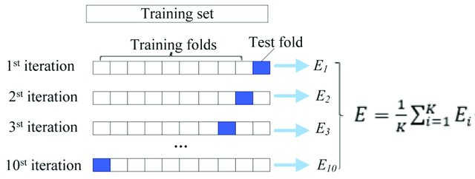
10-FOLD CROSS VALIDATION?

Slide 8
K-Nearest Neighbors
a non-parametric, supervised learning classifier
uses proximity to make classifications or predictions about the grouping of an individual data point
can be used for either regression or classification problems
typically used as a classification algorithm
Assumption → that similar points can be found near one another

Slide 9
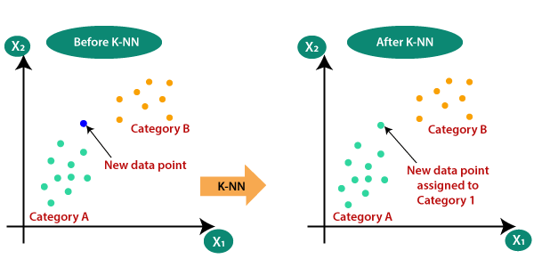
K-Nearest Neighbors – distance metrics
A
For k=1, assign the class/category of the nearest data point to the new data point

Slide 10
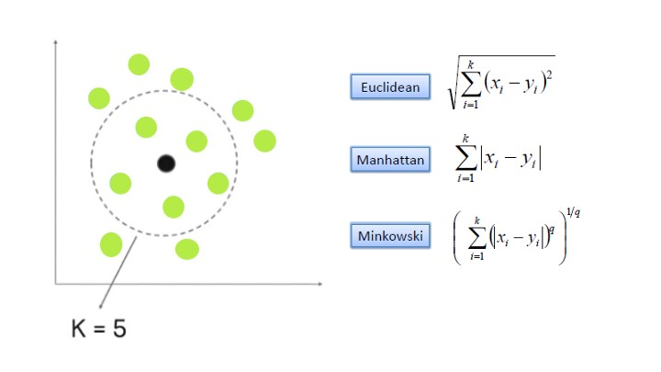
K-Nearest Neighbors – distance metrics
A

Slide 11
K-Nearest Neighbors – EXAMPLE
Suppose that we have a dataset
containing 4 people (training data set)
Aim → to predict whether a person has cancer or not (independent test set)
Represent each person with 2 features
Inputs: x1, x2 {blood pressure, glucose level}
Outputs: Y→{0 or 1} → {healthy, cancer}

Slide 12
K-Nearest Neighbors – EXAMPLE
X1 (blood pressure) | X2 (glucose level) | Class/Category
7 | 7 | 1
7 | 4 | 1
3 | 4 | 0
1 | 4 | 0
3 | 7 | ?
QUERY SAMPLE: we want to predict whether this person has cancer!

Slide 13
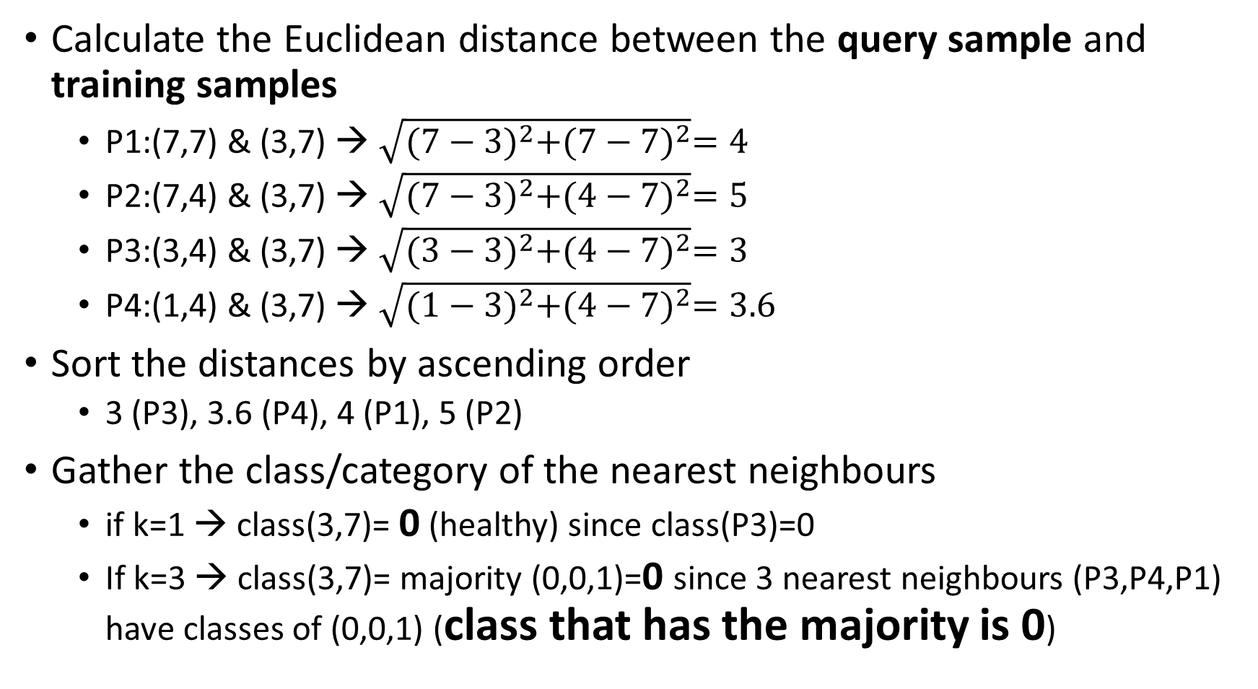
K-Nearest Neighbors – EXAMPLE
Calculate the Euclidean distance between the query sample and training samples
P1:(7,7) & (3,7) → $\sqrt{{(7−3)}^{2}+{(7−7)}^{2}}=4$
P2:(7,4) & (3,7) → $\sqrt{{(7−3)}^{2}+{(4−7)}^{2}}=5$
P3:(3,4) & (3,7) → $\sqrt{{(3−3)}^{2}+{(4−7)}^{2}}=3$
P4:(1,4) & (3,7) → $\sqrt{{(1−3)}^{2}+{(4−7)}^{2}}=3.6$
Sort the distances by ascending order
3 (P3), 3.6 (P4), 4 (P1), 5 (P2)
Gather the class/category of the nearest neighbours
if k=1 → class(3,7)= 0 (healthy) since class(P3)=0
If k=3 → class(3,7)= majority (0,0,1)=0 since 3 nearest neighbours (P3,P4,P1) have classes of (0,0,1) (class that has the majority is 0)

Slide 14
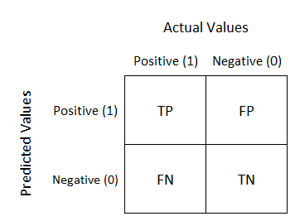
EVALUATION METRICS FOR A CLASSIFIER
PERFORMANCE OF A BINARY CLASSIFIER
CONFUSION MATRIX
TP→ true positive
FP→ false positive
TN→ true negative
FN→ false negative

Slide 15
EVALUATION METRICS FOR A CLASSIFIER
Accuracy= (TP+TN)/(TP+TN+FP+FN)
Sensitivity (RECALL, TRUE POSITIVE RATE)= TP/(TP+FN)
Specificity (TRUE NEGATIVE RATE)=TN/(TN+FP)
Precision (positive predictive value)= TP/(TP+FP)

Slide 16
EVALUATION METRICS FOR A CLASSIFIER – EX.
CM FOR A CLASSIFIER/MODEL ON AN INDEPENDENT TEST DATA SET
 |  | ACTUAL/REAL CLASS
 |  | CANCER (1) | HEALTHY (0)
PREDICTED CLASS | CANCER (1) | 6 | 1
 | HEALTHY (0) | 2 | 3
# of samples: 12
# of cancer patients: 8
# of healthy people: 4
TP:6
TN:3
FP:1
FN:2
Acc=9/12=0.75
Sn= 6/8=0.75
Sp=3/4=0.75
Precision= 0.86 (6/7)

